Slide 1


CITS1003 Introduction to Cybersecurity [9-A] Cyber Law and CI & CPS exercises
Dr Zhi Zhang

Slide 2
Privacy preserving
Secure Multi-Party Computation (SMPC)
Differential Privacy (DP)
Homomorphic Encryption (HE)
Software-induced hardware vulnerability: Rowhammer

Slide 3
What is privacy
Privacy refers to the ability of individuals to control the access and use of their personal information (e.g., gender, age, phone number, etc).

Slide 4


What is Privacy
provides personal information
to sign up for a membership
Alice
Why does Costco collect users’ private data?

Slide 5
What is Privacy
Model Training
provide users’ data
Well-trained
Model
e.g., her favourite items

Slide 6
What is Privacy Preserving
provide anonymized
users’ data
Model Training

Slide 7
What is Privacy Preserving
Privacy preserving
protects data from being disclosed to unauthorized parties
enables the collection and analysis of data

Slide 8
What is Privacy Preserving
Privacy preserving
protect data from being disclosed to unauthorized parties
enable the collection, and analysis of data
How to collect and analyze data without leaking private information?

Slide 9
Privacy Preserving
Privacy preserving
protect data from being disclosed to unauthorized parties
enable the collection, and analysis of data
How to collect and analyze data without leaking private information?
Data anonymization: irreversibly hide personal identifiers that may lead to an individual being identified
e.g., data masking: remove personally identifiable data such as user names and credit card details.

Slide 10
Privacy Preserving
Data anonymisation: removing personal identifiers that may lead to an individual being identified
Data anonymisation is NOT secure enough
e.g., data linking attack: correlates anonymized data with publicly available data sources to re-identify individuals.

Slide 11
What is Privacy Preserving
A Hospital
A Third-party
Data Analytics Company
Raw Medical Records
(e.g., patients’ names, gender, age, addresses and postcode)
Public Data
Data Anonymization
Individual Re-identification
Anonymized Medical Records
(e.g., names and addresses are masked,
while gender, age and postcode are kept)
A Third-party
Data Analytics Company

Slide 12
Privacy Preserving
Data anonymisation: removing personal identifiers that may lead to an individual being identified
Data anonymisation is NOT secure enough
Secure multi-party computation
Differential privacy
Homomorphic encryption

Slide 13
Secure Multi-party Computation
Secure multi-party computation is a privacy concept that distributes a computation across multiple users where no user can see the other users' data.

Slide 14
Secure Multi-party Computation
Secure multi-party computation is a privacy concept that distributes a computation across multiple users where no user can see the other users' data.
e.g., Additive secret sharing
Additive Secret Sharing refers to the division of a secret and its distribution among a group of independent participants.

Slide 15

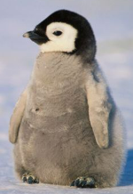
Secure Multi-party Computation
Situation: Three coworkers--Alice, Bob and Penguin—want to compute their average hourly rate
Requirement: They do not want to reveal their rate to each other or a third-party.
Alice (A)
$50
Bob (B)
$120
Penguin (P)
$180

Slide 16
Secure Multi-party Computation
Steps:
1. Each staff split their rate randomly into n (n=3) secret shares
A: $50
B: $120
P: $180

Slide 17
Secure Multi-party Computation
Steps:
1. Each staff split their rate randomly into 3 secret shares
A: $50 -> $10, $5, $35
B: $120 -> $25, $100, -$5
P: $180 -> $10, $100, $70
2. Each staff keeps one secret share and distributes the remaining two secret shares to the other two staffs.

Slide 18
Secure Multi-party Computation
After secret sharing is completed:
A | B | P
5 | 35 | 10
100 | 25 | -5
70 | 10 | 100
A = 50
B = 120
P = 180

Slide 19
Secure Multi-party Computation
After secret sharing is completed:
A
5
100
70
A = 50
B = 120
P = 180

Slide 20
Secure Multi-party Computation
After secret sharing is completed:
 | B
 | 35
 | 25
 | 10
A = 50
B = 120
P = 180

Slide 21
Secure Multi-party Computation
After secret sharing is completed:
 |  | P
 |  | 10
 |  | -5
 |  | 100
A = 50
B = 120
P = 180

Slide 22
Secure Multi-party Computation
After secret sharing is completed:
A | B | P
5 | 35 | 10
100 | 25 | -5
70 | 10 | 100
175 | 70 | 105
A = 50
B = 120
P = 180
Sum: 350
Average: 350/3 = 116.67

Slide 23
Secure Multi-party Computation
What are limitations of SMPC in practice?

Slide 24
Secure Multi-party Computation
What are limitations of SMPC in practice?
e.g., computational overhead and communication cost

Slide 25
Secure Multi-party Computation
What if one coworker is dishonest and distributes false secret shares?
e.g., Zero Knowledge Proof
Zero Knowledge Proof is a cryptographic protocol by which one party (a prover) can prove to another party (a verifier) that something is true, without revealing any information apart from the fact that this specific statement is true.

Slide 26
Zero Knowledge Proof
Situation: Alice and Bob want to find a friend called Wally in a given image. Alice has knowledge of where Wally is in the image, but Bob doesn’t believe Alice.
How does Alice prove to Bob that she knows where Wally is without giving away Wally’s location in the image?

Slide 27
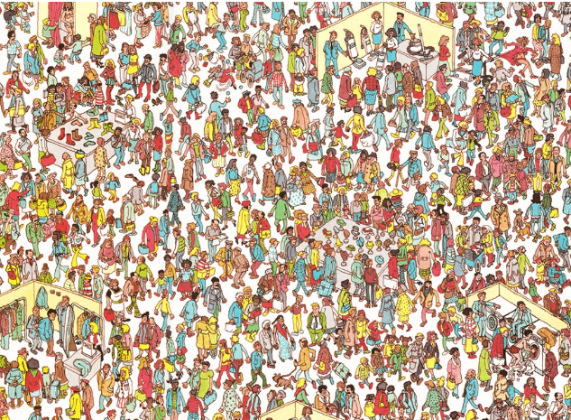

Slide 29
Zero Knowledge Proof
Situation: Bob meets Alice that he does not know, yet Alice claims to be a member of a group that Bob is also a part of.
How can Bob know if he can trust her? Assume the group has a locked safe, and only the group members know the secret pin code to gain access to the safe.
e.g., sharing their pin code with a trusted third party, showing Bob that Alice can open the locked safe, etc.

Slide 30
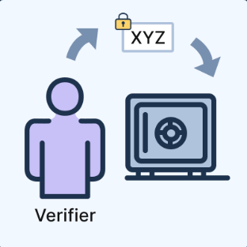
Zero Knowledge Proof
Steps:
1. The verifier Bob writes a secret message and puts it in the locked safe

Slide 31
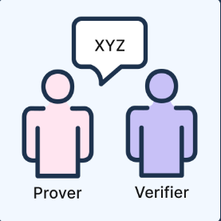
Zero Knowledge Proof
Steps:
2. The prover Alice has knowledge of the pin code and opens the locked safe

Slide 32
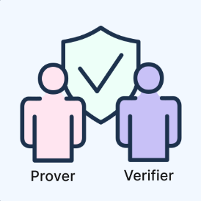
Zero Knowledge Proof
Steps:
3. The prover Alice returns the secret message to the verifier Bob

Slide 33
Differential Privacy
Differential privacy (DP) is also a concept in privacy that aims to provide strong guarantees for protecting the privacy of individuals in a dataset while allowing statistical analysis of the dataset.

Slide 34
Differential Privacy
Differential privacy (DP) is also a concept in privacy that aims to provide strong guarantees for protecting the privacy of individuals in a dataset while allowing statistical analysis of the dataset.
The key difference between DP and SMPC
DP focuses on a single party with sensitive dataset
SMPC focuses on multiple parties that perform a collaborative computation

Slide 35
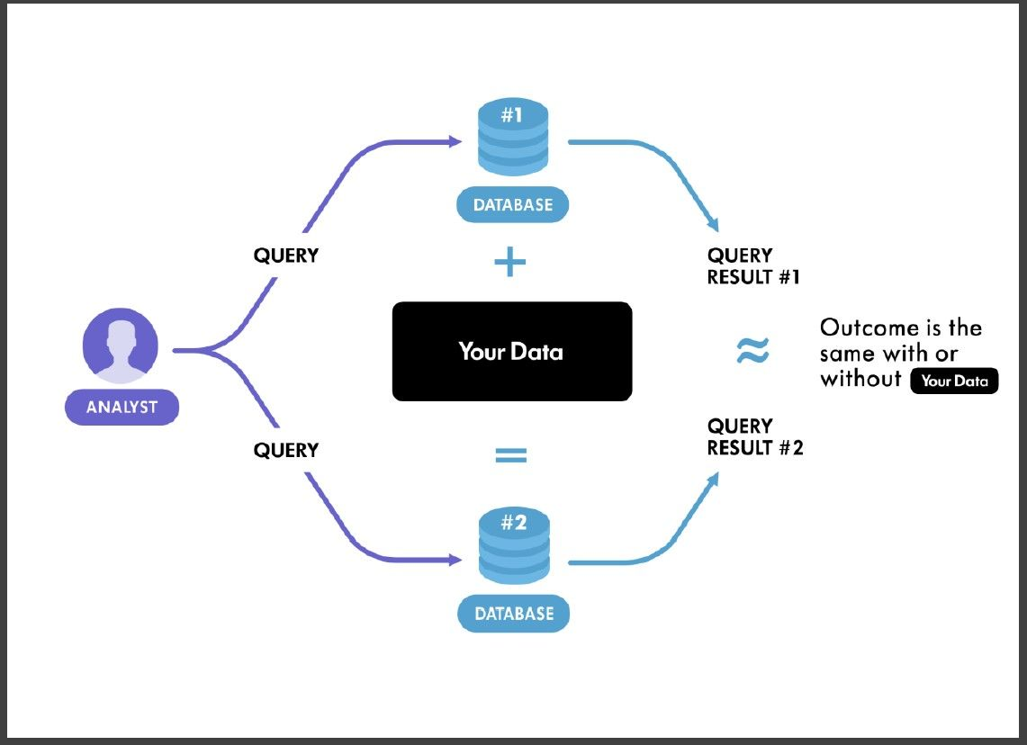
Differential Privacy

Slide 36
Differential Privacy
What are some limitations of DP?

Slide 37
Differential Privacy
What are some limitations of DP?
e.g., limited accuracy and high computational complexity.

Slide 38
Homomorphic Encryption
Homomorphic Encryption (HE) is a type of encryption that allows computations to be performed on encrypted data, making itself computationally expensive.

Slide 39
Homomorphic Encryption
Homomorphic Encryption (HE) is a type of encryption that allows computations to be performed on encrypted data, making itself computationally expensive.
HE
encryption
computing
operation
HE
decryption
Encrypted
Texts
Encrypted
Computation Results
Decrypted Computation Results
Plaintext
same computing operation
Computation Results

Slide 40

Homomorphic Encryption
Cloud Server
Computed Result:
F(E(A), E(B))
Ciphertext E(A)
Ciphertext E(B)
Computing Request:
F()
HE Encryption
HE Decryption
Plaintext A
Plaintext B
Decrypted Computed Result:
D(F(E(A), E(B)))
Alice

Slide 41
Homomorphic Encryption
Fully HE (FHE) enables any computations to be performed on encrypted data, such as addition, subtraction, multiplication and division.
Partially HE (PHE) enables certain types of computations (not all) to be performed on encrypted data. Specifically, PHE allows for either addition or multiplication operations.

Slide 42
Homomorphic Encryption
Fully HE (FHE) enables any computations to be performed on encrypted data, such as addition, subtraction, multiplication and division.
e.g., BGV (Brakerski-Gentry-Vaikuntanathan)
Partially HE (PHE) enables certain types of computations (not all) to be performed on encrypted data. Specifically, PHE allows for either addition or multiplication operations.
e.g., RSA (homomorphic multiplication)
Paillier (homomorphic addition)

Slide 43
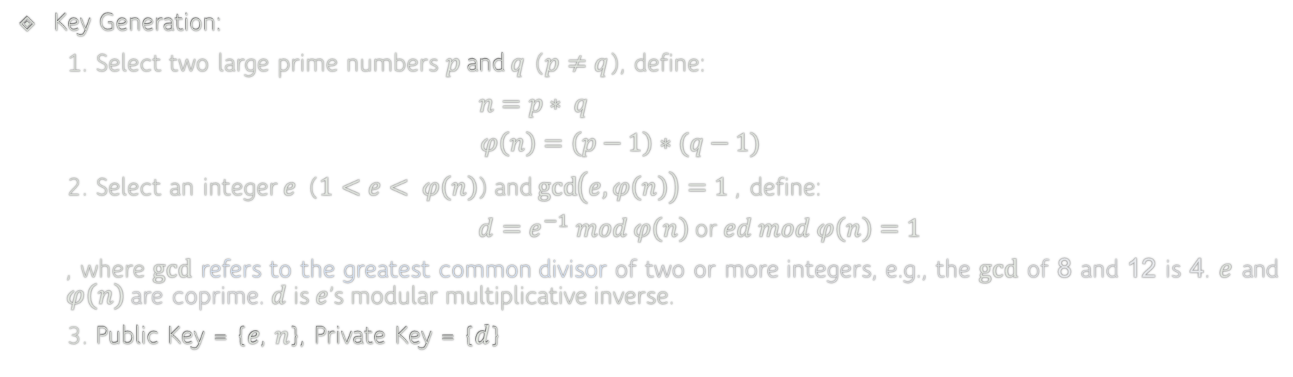
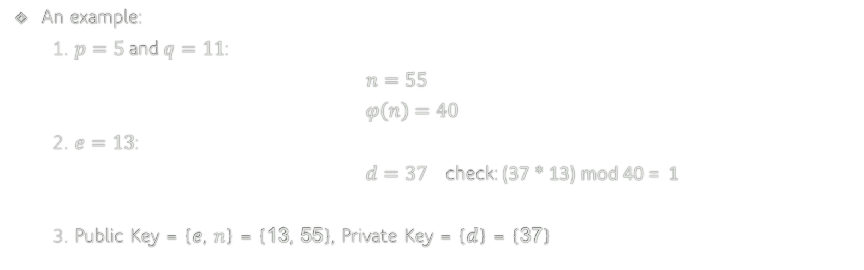
RSA
Key Generation:
1. Select two large prime numbers $p$ and $q$ ($p≠q$), define:
$n=p∗ q$
$$φ\left(n\right)=\left(p−1\right)∗(q−1)$$
2. Select an integer $e$ ($1<e< φ\left(n\right)$) and $\gcd\left(e, φ\left(n\right)\right)=1$ , define:
$d=e^{−1} mod φ\left(n\right)$ or $ed mod φ\left(n\right)=1$
, where $gcd$ refers to the greatest common divisor of two or more integers, e.g., the $gcd$ of 8 and 12 is 4. $e$ and $φ\left(n\right)$are coprime. $d$ is $e$’s modular multiplicative inverse.
3. Public Key = {$e$, $n$}, Private Key = {$d$}
An example:
1. $p=5$ and $q=11$:
$n=55$
$$φ\left(n\right)=40$$
2. $e=13$:
$d=37$ check: (37 * 13) mod 40 = 1
3. Public Key = {$e$, $n$} = {13, 55}, Private Key = {$d$} = {37}

Slide 44







RSA: Secure Communication
Bob’s Public Key ($e$, $n$)
Bob’s Private key ($d$)
Plaintext m
Plaintext m
RSA encryption
$$c= m^{e} mod n$$
RSA decryption
$$m= c^{d} mod n$$
Alice
Cipher-text c
Bob

Slide 45

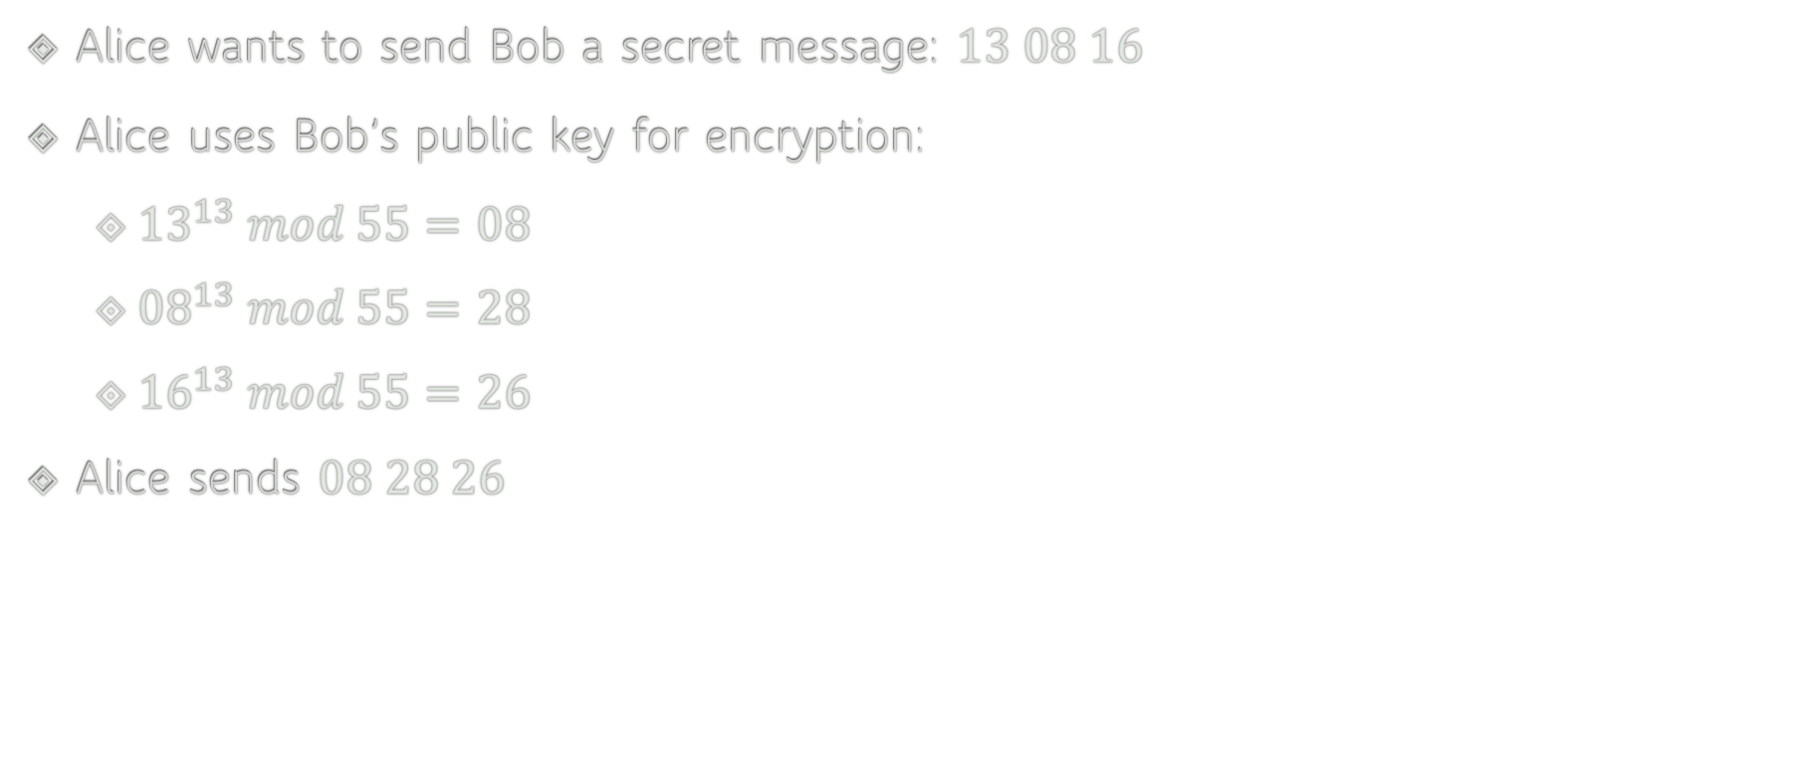

RSA: Encryption
Alice wants to send Bob a secret message: $13 08 16$
Alice uses Bob’s public key for encryption:
${13}^{13} mod 55=08$
${08}^{13} mod 55=28$
${16}^{13} mod 55=26$
Alice sends $08 28 26$
Public Key = {$e$, $n$} = {$13$, $55$}
RSA encryption
$$c= m^{e} mod n$$

Slide 46

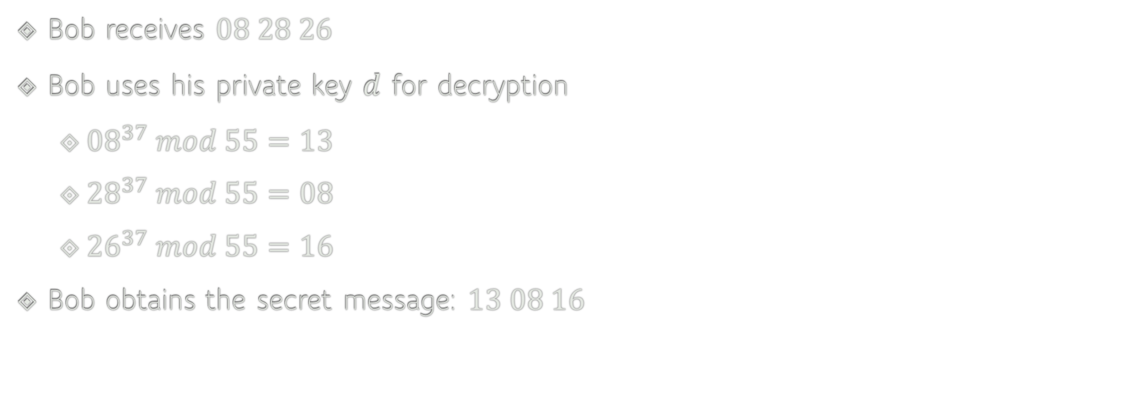

RSA: Decryption
Bob receives $08 28 26$
Bob uses his private key $d$ for decryption
${08}^{37} mod 55=13$
${28}^{37} mod 55=08$
${26}^{37} mod 55=16$
Bob obtains the secret message: $13 08 16$
Private Key = {$d$} = {$37$}
RSA decryption
$$m= c^{d} mod n$$

Slide 47
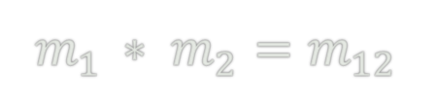
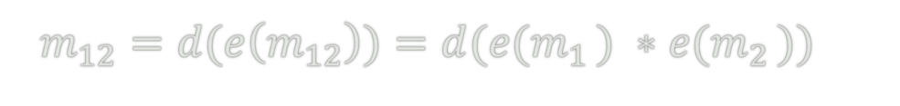

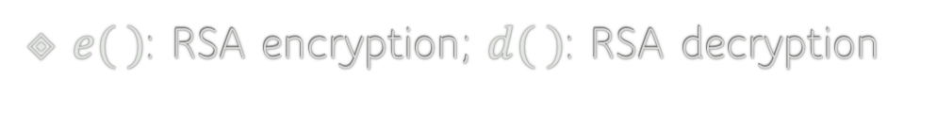
RSA: Homomorphic Multiplication
$e( )$: RSA encryption; $d( )$: RSA decryption
$$m_{1 }∗ m_{2}=m_{12}$$
$${e(m}_{1 })∗{e(m}_{2 })={e(m}_{1 }∗ m_{2})=e(m_{12})$$
Homomorphic Multiplication
$m_{12}={d(e\left(m_{12}\right))=d(e(m}_{1 }) ∗{e(m}_{2 }))$

Slide 48
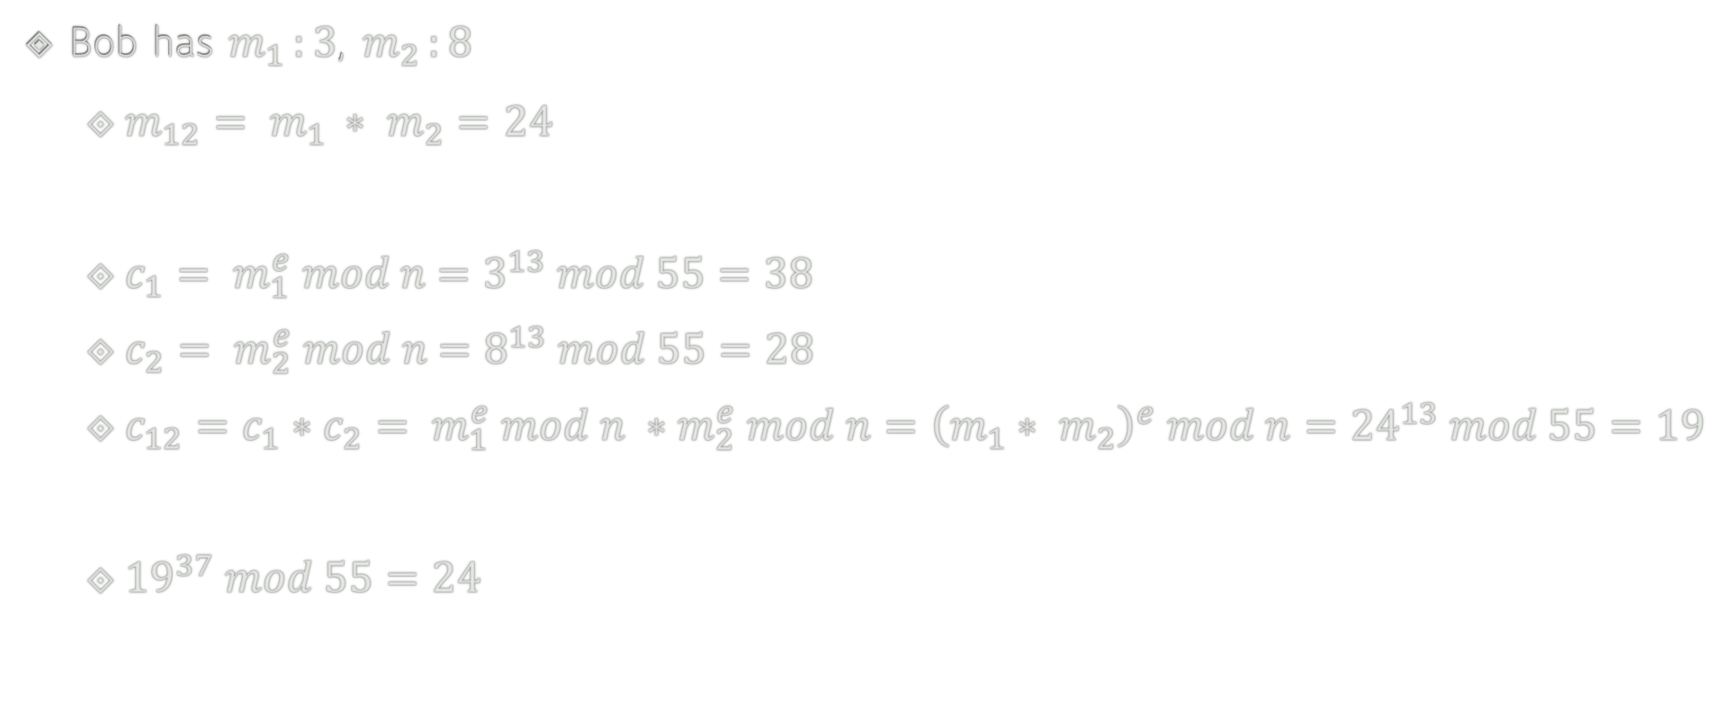


RSA: Homomorphic Multiplication
Bob has $m_{1 }:3$, $m_{2 }:8$
$m_{12}= m_{1 }∗ m_{2}=24$
$c_{1}= m_{1}^{e} mod n$ $=3^{13} mod 55=38$
$c_{2}= m_{2}^{e} mod n$ $=8^{13} mod 55=28$
$c_{12}=c_{1}∗c_{2}= m_{1}^{e} mod n ∗m_{2}^{e} mod n={\left(m_{1}∗ m_{2}\right)}^{e} mod n={24}^{13} mod 55=19$
${19}^{37} mod 55=24$
Public Key = {$e$, $n$} = {$13$, $55$}
Private Key = {$d$} = {$37$}

Slide 49
RSA: Homomorphic Multiplication
Bob has $m_{1 }:3$, $m_{2 }:8$
$m_{12}= m_{1 }∗ m_{2}=24$
$c_{1}= m_{1}^{e} mod n$ $=3^{13} mod 55=38$
$c_{2}= m_{2}^{e} mod n$ $=8^{13} mod 55=28$
$c_{12}=c_{1}∗c_{2}= m_{1}^{e} mod n ∗m_{2}^{e} mod n={\left(m_{1}∗ m_{2}\right)}^{e} mod n={24}^{13} mod 55=19$
${19}^{37} mod 55=24$
Public Key = {$e$, $n$} = {$13$, $55$}
Private Key = {$d$} = {$37$}

Slide 50
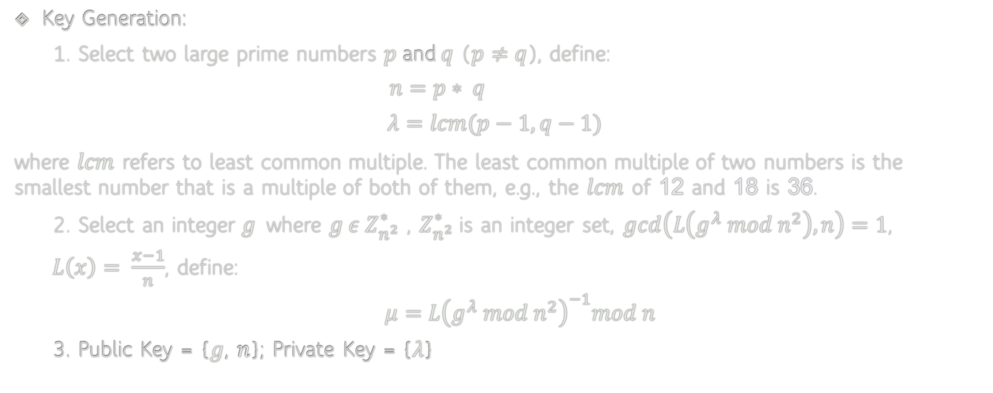
Paillier
Key Generation:
1. Select two large prime numbers $p$ and $q$ ($p≠q$), define:
$n=p∗ q$
$$λ=lcm(p−1, q−1)$$
where $lcm$ refers to least common multiple. The least common multiple of two numbers is the smallest number that is a multiple of both of them, e.g., the $lcm$ of 12 and 18 is 36.
2. Select an integer $g$ where $g ε Z_{n^{2}}^{∗}$ , $Z_{n^{2}}^{∗}$ is an integer set, $gcd\left(L\left(g^{λ} mod n^{2}\right), n\right)=1$,
$L\left(x\right)= \frac{x−1}{n}$, define:
$μ={L\left(g^{λ} mod n^{2}\right)}^{−1}mod n$
3. Public Key = {$g$, $n$}; Private Key = {$λ$}

Slide 51
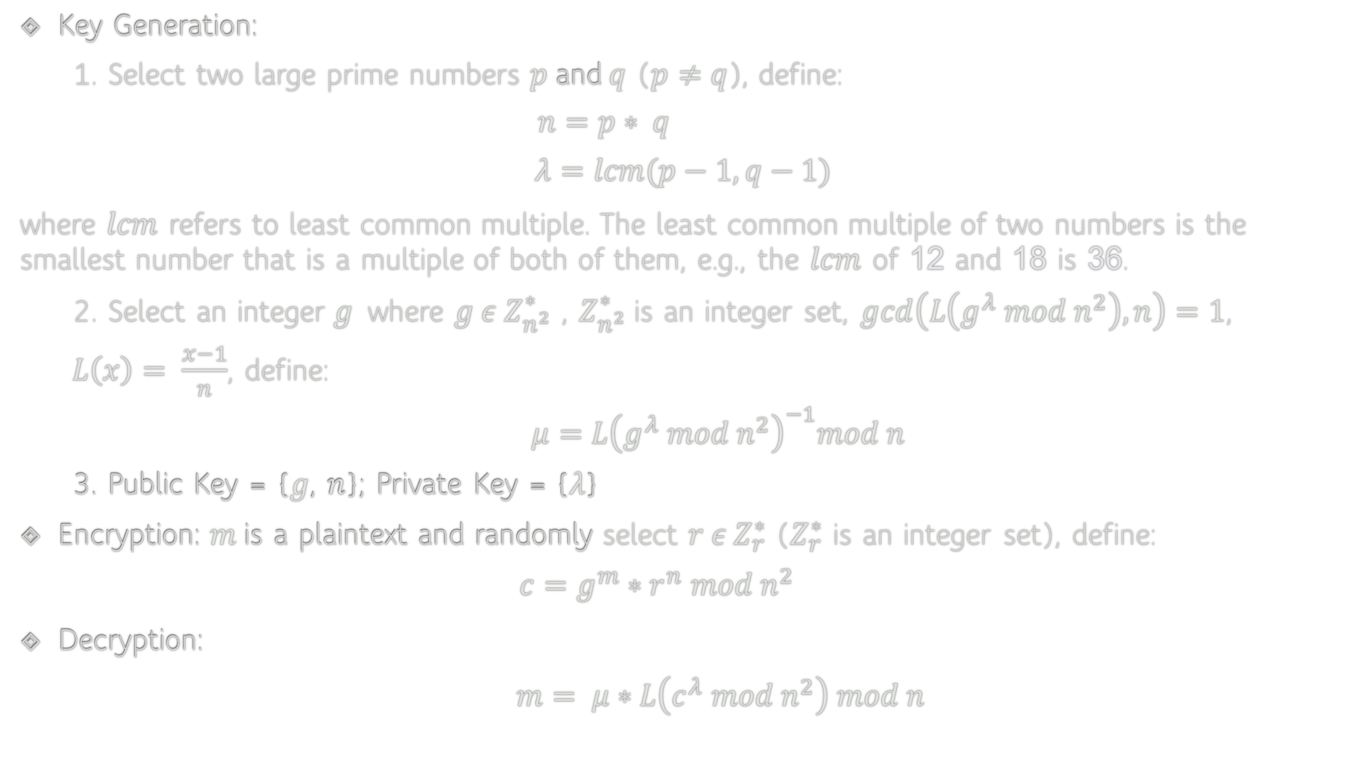
Paillier
Key Generation:
1. Select two large prime numbers $p$ and $q$ ($p≠q$), define:
$n=p∗ q$
$$λ=lcm(p−1, q−1)$$
where $lcm$ refers to least common multiple. The least common multiple of two numbers is the smallest number that is a multiple of both of them, e.g., the $lcm$ of 12 and 18 is 36.
2. Select an integer $g$ where $g ε Z_{n^{2}}^{∗}$ , $Z_{n^{2}}^{∗}$ is an integer set, $gcd\left(L\left(g^{λ} mod n^{2}\right), n\right)=1$,
$L\left(x\right)= \frac{x−1}{n}$, define:
$μ={L\left(g^{λ} mod n^{2}\right)}^{−1}mod n$
3. Public Key = {$g$, $n$}; Private Key = {$λ$}
Encryption: $m$is a plaintext and randomly select $r ε Z_{r}^{∗}$ ($Z_{r}^{∗}$ is an integer set), define:
$c=g^{m}∗r^{n} mod n^{2}$
Decryption:
$m= μ∗L\left(c^{λ} mod n^{2}\right) mod n$

Slide 52
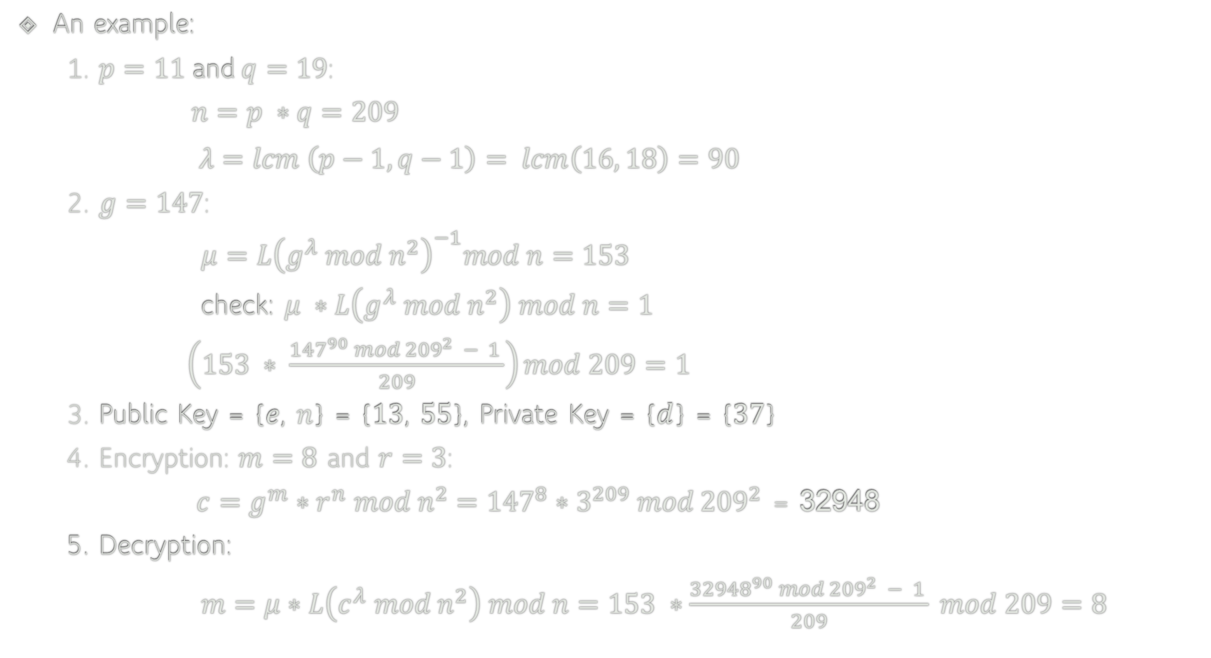
Paillier
An example:
1. $p=11$ and $q=19$:
$n=p ∗q=209$
$λ=lcm \left(p−1, q−1\right)= lcm\left(16, 18\right)=90$
2. $g=147$:
$μ={L\left(g^{λ} mod n^{2}\right)}^{−1}mod n=153$
check: $μ ∗L\left(g^{λ} mod n^{2}\right) mod n=1$
$\left(153 ∗ \frac{{147}^{90} mod {209}^{2} − 1 }{209}\right)mod 209=1$
3. Public Key = {$e$, $n$} = {13, 55}, Private Key = {$d$} = {37}
4. Encryption: $m=8$ and $r=3$:
$c={g^{m}∗r^{n} mod n^{2}=147}^{8}∗3^{209} mod {209}^{2}$ = 32948
5. Decryption:
$m=μ∗L\left(c^{λ} mod n^{2}\right) mod n=153 ∗\frac{{32948}^{90} mod {209}^{2} − 1 }{209} mod 209=8$

Slide 53
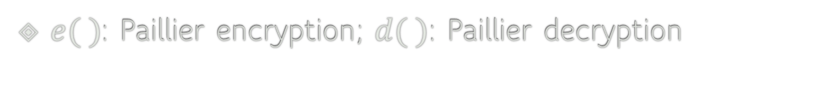
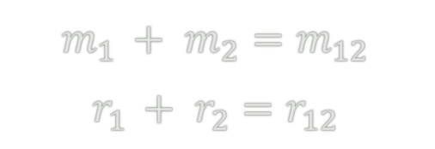
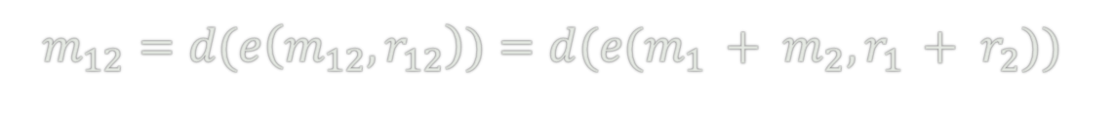
Paillier: Homomorphic Addition
$e( )$: Paillier encryption; $d( )$: Paillier decryption
$$m_{1 }+ m_{2}=m_{12}$$
$$r_{1 }+ r_{2}=r_{12}$$
$${e(m}_{1 }, r_{1 })∗{e(m}_{2 }, r_{2 })={e(m}_{1 }+ m_{2}, r_{1 }+ r_{2})=e(m_{12}, r_{12})$$
Homomorphic Addition
$m_{12}={d(e\left(m_{12}, r_{12}\right))=d(e(m}_{1 }+ m_{2}, r_{1 }+ r_{2}))$

Slide 54
Homomorphic Encryption
What are the pros and cons of HE compared to SMPC and DP?

Slide 55
Homomorphic Encryption
What are the pros and cons of HE?
Pros:
HE allows computation on encrypted data, ensuring data privacy.
HE is versatile as it can be used for many privacy-preserving tasks.
Cons:
HE is computationally expensive, and the computational overhead increases with the complexity of the computation.

Slide 56
Rowhammer
Rowhammer is a severe security vulnerability in dynamic random-access memory (DRAM), which can be induced by an unprivileged attacker.
DRAM Memory
Disk Storage

Slide 57
Rowhammer
Rowhammer is a severe security vulnerability in dynamic random-access memory (DRAM), which can be induced by an unprivileged attacker.
DRAM Memory
DRAM is volatile memory that stores data temporarily while the computer is running.
Disk Storage
Disk space refers to the amount of non-volatile storage space available on a disk drive.

Slide 58
Rowhammer
Rowhammer is a severe security vulnerability in dynamic random-access memory (DRAM), which can be induced by an unprivileged attacker.
Rowhammer can badly affect any devices that use DRAM, including but not limited to:
IoT devices such as routers and smart home devices.
Personal computers such as Desktops and laptops.
Mobile devices such as smartphones and tablets.
Servers

Slide 59
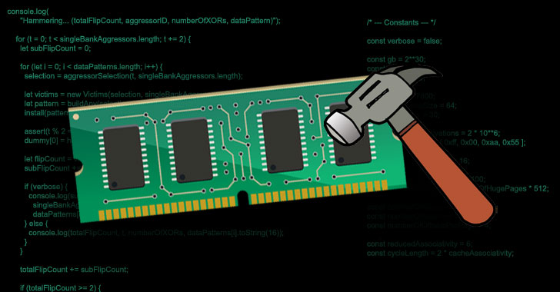
Rowhammer
DRAM rows
Frequently accessing
Rowhammer
https://thehackernews.com/2021/04/new-javascript-exploit-can-now-carry.html

Slide 60
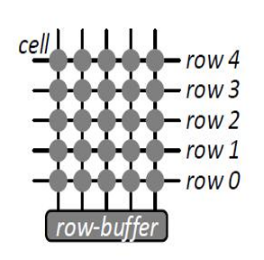
Structure of A DRAM Bank
Each cell is charged or discharged
A bank has rows of cells
Bank Layout
Diagram from Kim et al.

Slide 61
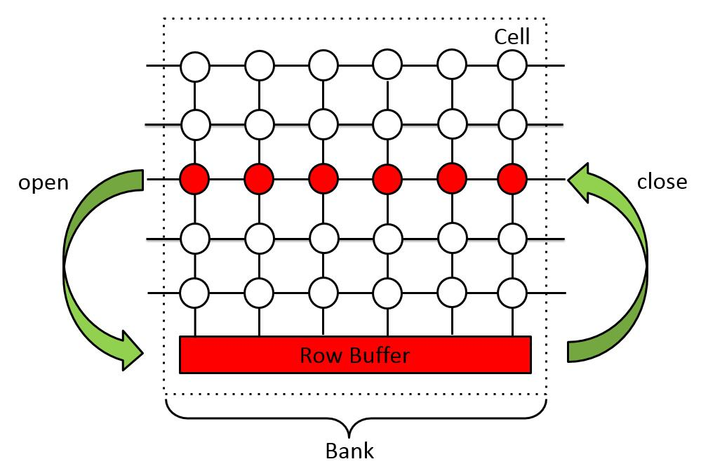
Memory access
Activating/opening a row
Accessing row buffer
Deactivating/closing the row

Slide 62
DRAM refresh
Cells can lose charge over time
A row of cells needs to be periodically charged/refreshed
The refresh interval is typically 64 ms

Slide 63
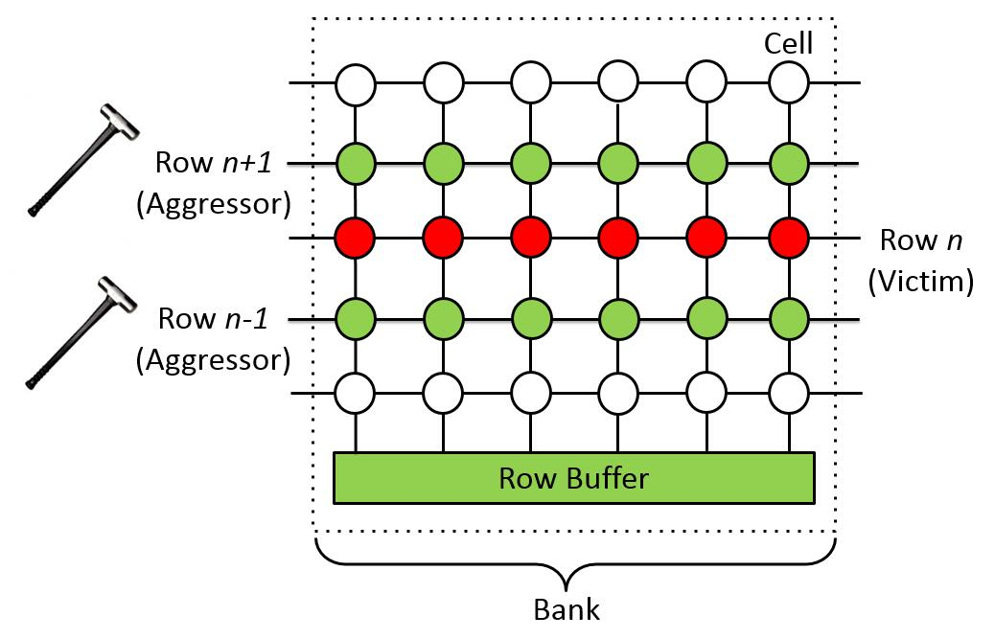
Rowhammer
Kim et al. key observation (ISCA’14)
Frequently opening rows n+1 & n-1 cause permanent charge leakage in row n. Permanent charge leakage means bit flips

Slide 64
Rowhammer
Double-sided hammer
Single-sided hammer
One-location hammer

Slide 65
Rowhammer
Kim et al. key observation (ISCA’14)
Motivated by Kim et al., we compromised a bug-free kernel by gaining privilege escalation in Blackhat’19
Blackhat’19: https://www.youtube.com/watch?v=7vQXhC6dq2Q&t=1930s

Slide 66
Rowhammer
PoC: Proof of Concept
OS
User Space
Attacker Process
Kernel Space
Page Table
Hardware (e.g., DRAM memory and Disk)

Slide 67

Rowhammer
PoC: Proof of Concept
attacker process
…
…
…
…
…
…
page table
…
…
…
…
…
…
attacker process

Slide 68
Rowhammer
PoC: Proof of Concept
$: a regular user process and its user id is greater than 0.
#: a root user process and its user id is set to 0.
In Linux kernel, a structure called ‘struct cred’ stores user id of a process.

Slide 69
Rowhammer code
Code from Kim et al.
1 loop:
2 mov (X), %eax
3 mov (Y), %ebx
4 clflush (X)
5 clflush (Y)
6 mfence
7 jmp loop
Flush/Evict CPU cache (e.g., clflush)
Clear row buffer (e.g., alternate access)

